Slide 1
Problem solving with perimeter, area and volume
Perimeter, area and volume

Slide 2
how to use Oak lessons

Slide 3
I can use my knowledge of perimeter, area and volume to solve problems.

Slide 4
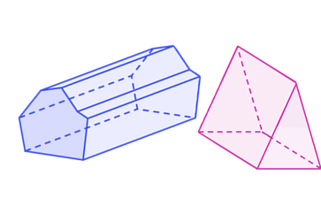
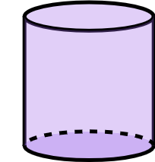
A prism is a polyhedron with a base that is a polygon and a parallel opposite face that is identical. The corresponding edges of the two polygons are joined by parallelograms.
A cylinder is a 3D shape with a base that is a circle and a parallel opposite face that is identical. A cross section of a cylinder made parallel to the base will be congruent to the base.
The surface area is the total area of all the surfaces of a closed 3D shape. The surfaces include all faces and any curved surfaces.
The volume is the amount of space occupied by a closed 3D shape.

Slide 5

Problem solving with perimeter, area and volume
Surface area and volume
Composite solids
Problems in context

Slide 6
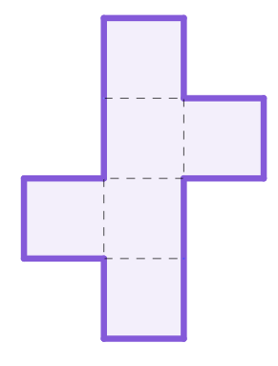
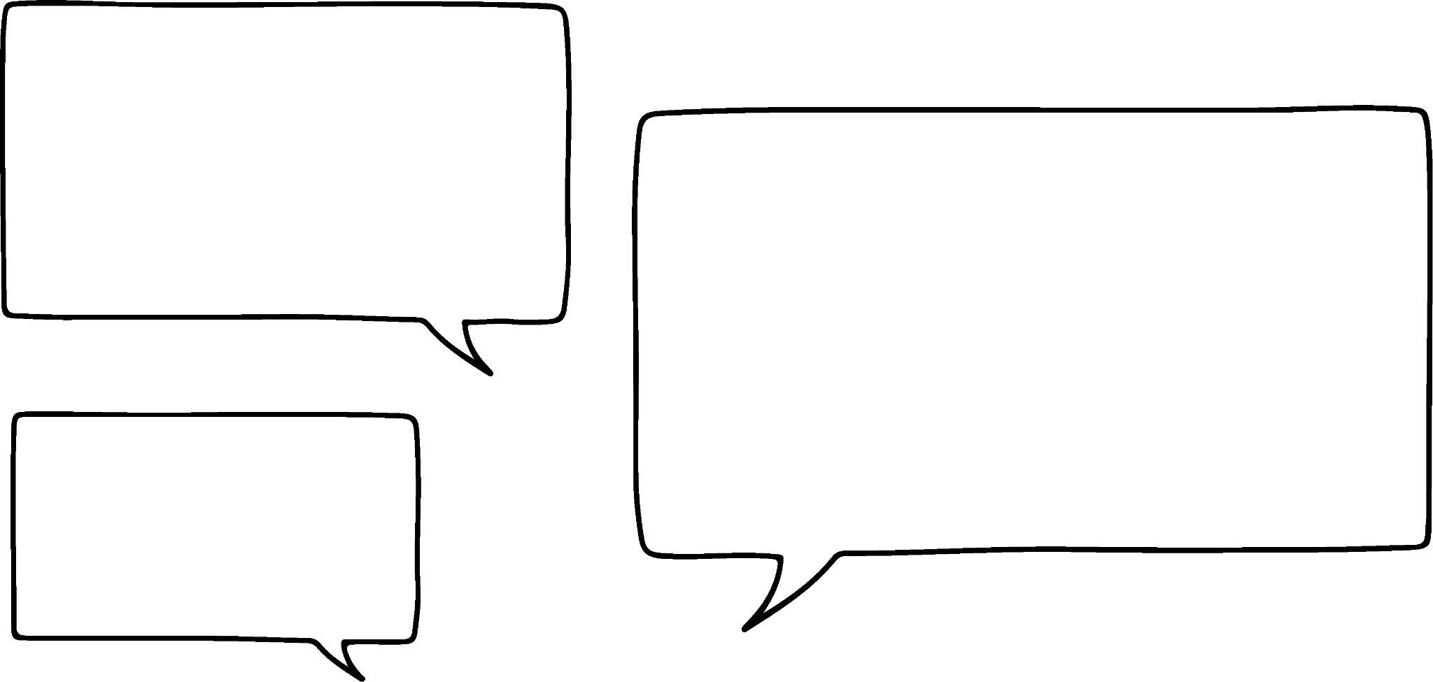



Surface area and volume
The volume of both the cube (represented here in net form) and cylinder are equal. Find the radius of the cylinder.
When faced with a problem, consider the given information and what other information that can give.
I know that all the faces of a cube are square, so all the edges are equal.
20 cm
The net shows that 4 edges is 20 cm.
Jun
4 cm
Jacob

Slide 7
Surface area and volume
The volume of both the cube (represented here in net form) and cylinder are equal. Find the radius of the cylinder.
When faced with a problem, consider the given information and what other information that can give.
Which means 1 edge is 5 cm. So the volume of the cube is 5 × 5 × 5 = 125 cm³
20 cm
So the cylinder is also 125 cm³
Jun
4 cm
Jacob

Slide 8
Surface area and volume
The volume of both the cube (represented here in net form) and cylinder are equal. Find the radius of the cylinder.
When faced with a problem, consider the given information and what other information that can give.
The height of the cylinder is 4 so the area of the circle is 125 ÷ 4 = 31.25 cm²
Which means the radius-squared is
31.25 ÷ 𝜋 = 9.94718394…
So the radius is 3.2 cm to 1 d.p.
20 cm
Jun
4 cm
Jacob

Slide 9

Surface area and volume
A cube has a volume of 27 m³. What information can you deduce from this?
54 m²
the surface area
9 m²
the area of one face
3 m
the edge length
42 m
the perimeter of the net

Slide 10
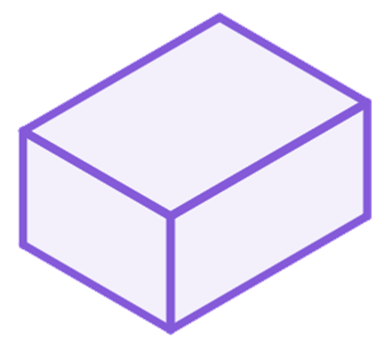
Surface area and volume
A cuboid has a volume of 585 cm³, a height of 5 cm and a length of 13 cm. What is the surface area of the cuboid?
Volume = l × w × h
h
Surface area = 2(w × h) + 2(w × l) + 2(l × h)
w
l
To calculate the surface area we need the width of the cuboid.
585 = 13 × w × 5
Surface area
= 2(9 × 5) + 2(9 × 13) + 2(13 × 5)
= 90 + 234 + 130 = 454 cm²
585 = 65w
9 = w

Slide 11
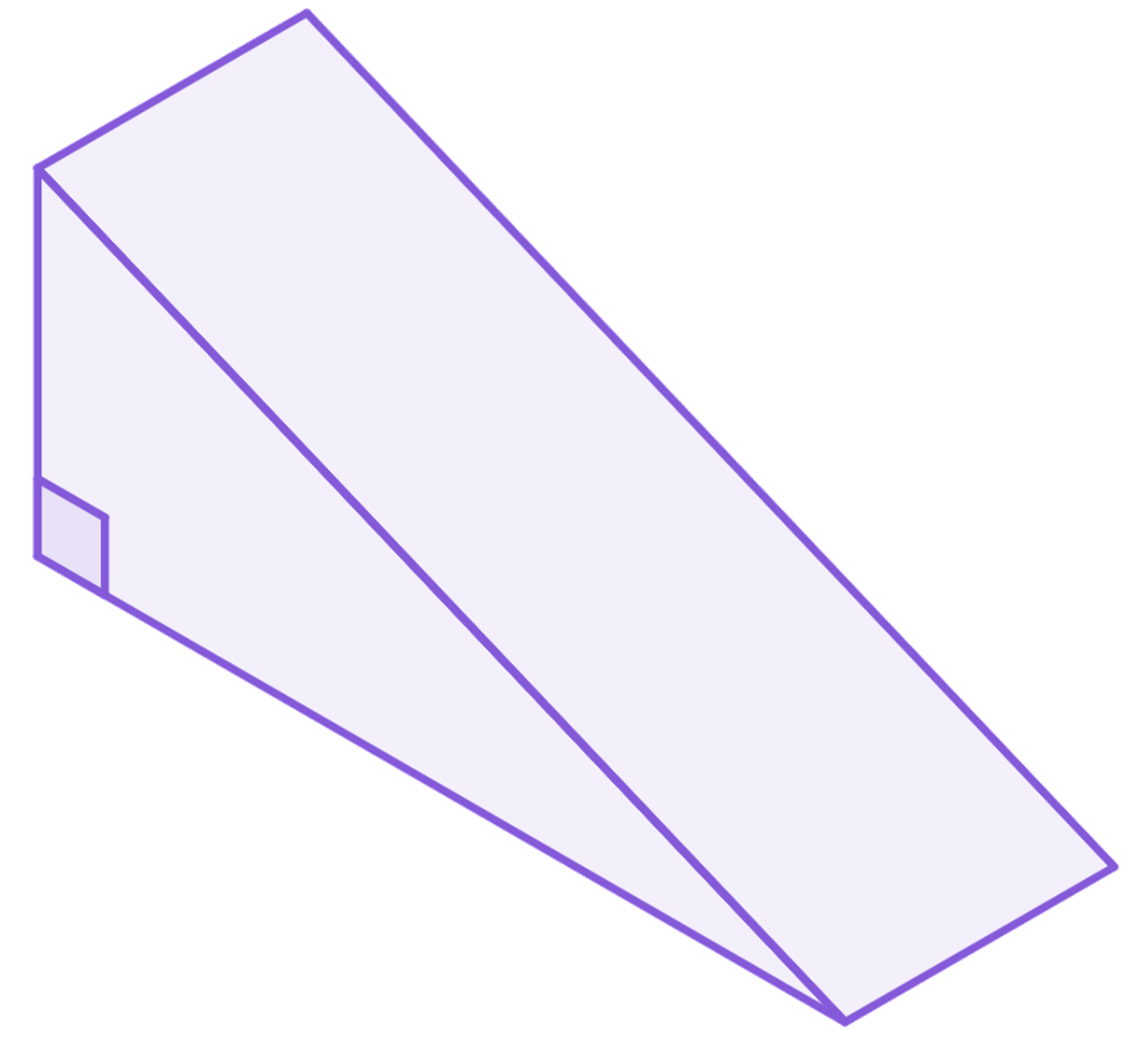
Surface area and volume
1) The surface area of this triangular prism is 240 cm².
a) What is the length of the prism?
b) Hence calculate the volume of the prism.
13 cm
5 cm
12 cm
l cm

Slide 12
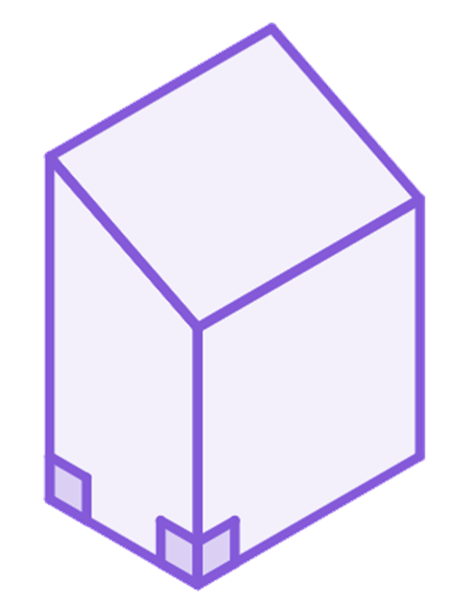
Surface area and volume
2) The volume of a cylinder is 324𝜋 cm³ and its height is 9 cm.
Work out the cylinder’s surface area.
3) The surface area of this prism is 516 cm².
Work out the volume of the prism.
5 cm
20 cm
17 cm
4 cm
l cm

Slide 13

Surface area and volume
4) The areas of three faces have been given. The edges are integer amounts of centimetres. What is the volume of this cuboid?
60 cm²
45
cm²
108 cm²

Slide 14

Surface area and volume
1) The surface area of this triangular prism is 240 cm².
a) What is the length of the prism?
b) Hence calculate the volume of the prism.
13 cm
5 cm
2( × 5 × 12) + 12l + 5l + 13l = 240
60 + 30l = 240
12 cm
30l = 180
l cm
l = 6
Volume = ( × 5 × 12) × 6 = 180 cm³

Slide 15
Surface area and volume
2) The volume of a cylinder is 324𝜋 cm³ and its height is 9 cm.
Work out the cylinder’s surface area.
Volume = 324𝜋
Surface area = 2𝜋r² + 2𝜋rh
𝜋r² × 9 = 324𝜋
Surface area = 2 × 36𝜋 + 2𝜋 × 6 × 9
𝜋r² = 36𝜋
Surface area = 72𝜋 + 108𝜋
r² = 36
Surface area = 180𝜋 cm²
r = 6

Slide 16

Surface area and volume
5 cm
3) The surface area of this prism is 516 cm².
Work out the volume of the prism.
Surface area = 516
17
cm
20 cm
2( × (20 + 17) × 4) + 20l + 4l + 17l + 5l = 516
148 + 46l = 516
l cm
4 cm
46l = 368
l = 8
Volume = ( × (20 + 17) × 4) × 8
Volume = 592 cm³

Slide 17
Surface area and volume
4) The areas of three faces have been given. The edges are integer amounts of centimetres. What is the volume of this cuboid?
Volume = 12 × 5 × 9 = 540 cm³
60 cm²
45
cm²
9 cm
108 cm²
12 cm
5 cm

Slide 18
Problem solving with perimeter, area and volume
Surface area and volume
Composite solids
Problems in context

Slide 19


Composite solids
All of these shapes can be classified as composite shapes.
A compound or composite shape is a shape created using two or more basic shapes.

Slide 20


Composite solids
In a similar way, there are composite solids: some are prisms, some are not.
Not a prism as this is not polygonal. Same structure though.

Slide 21






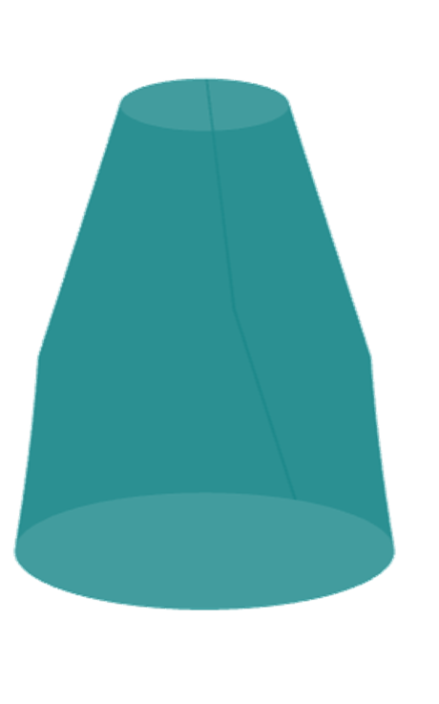
Composite solids
Which of these are composite prisms?

Slide 22
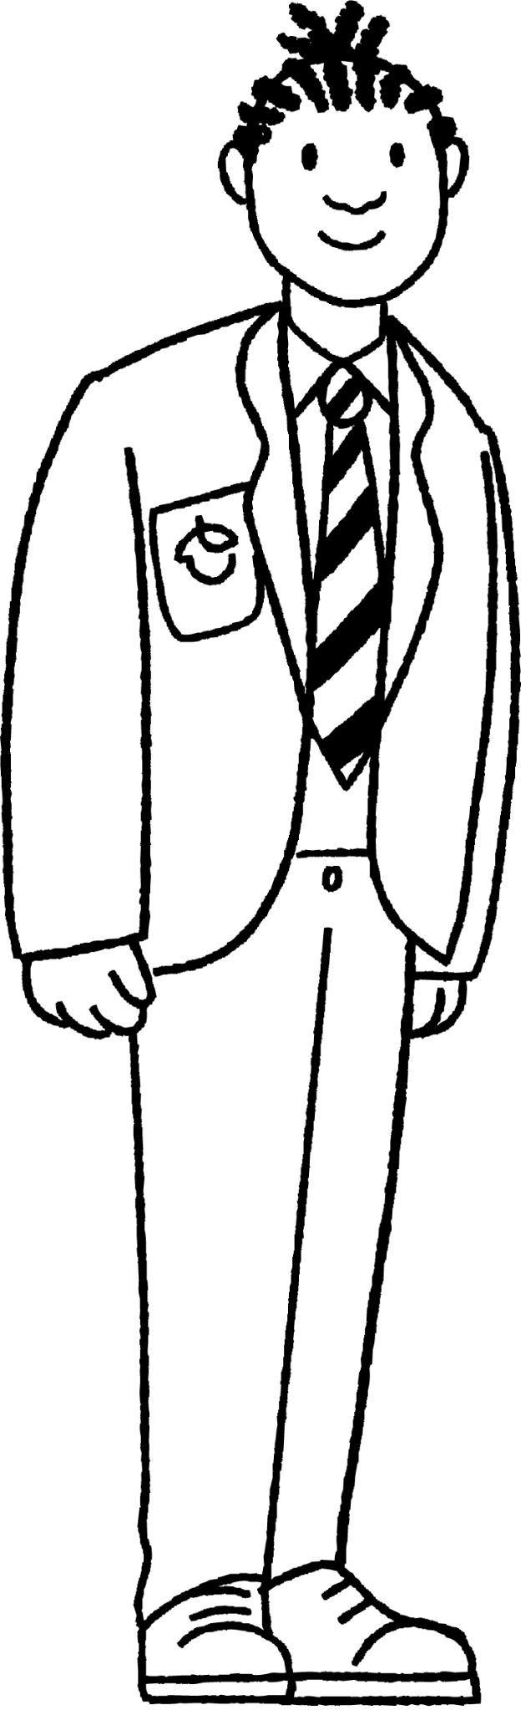
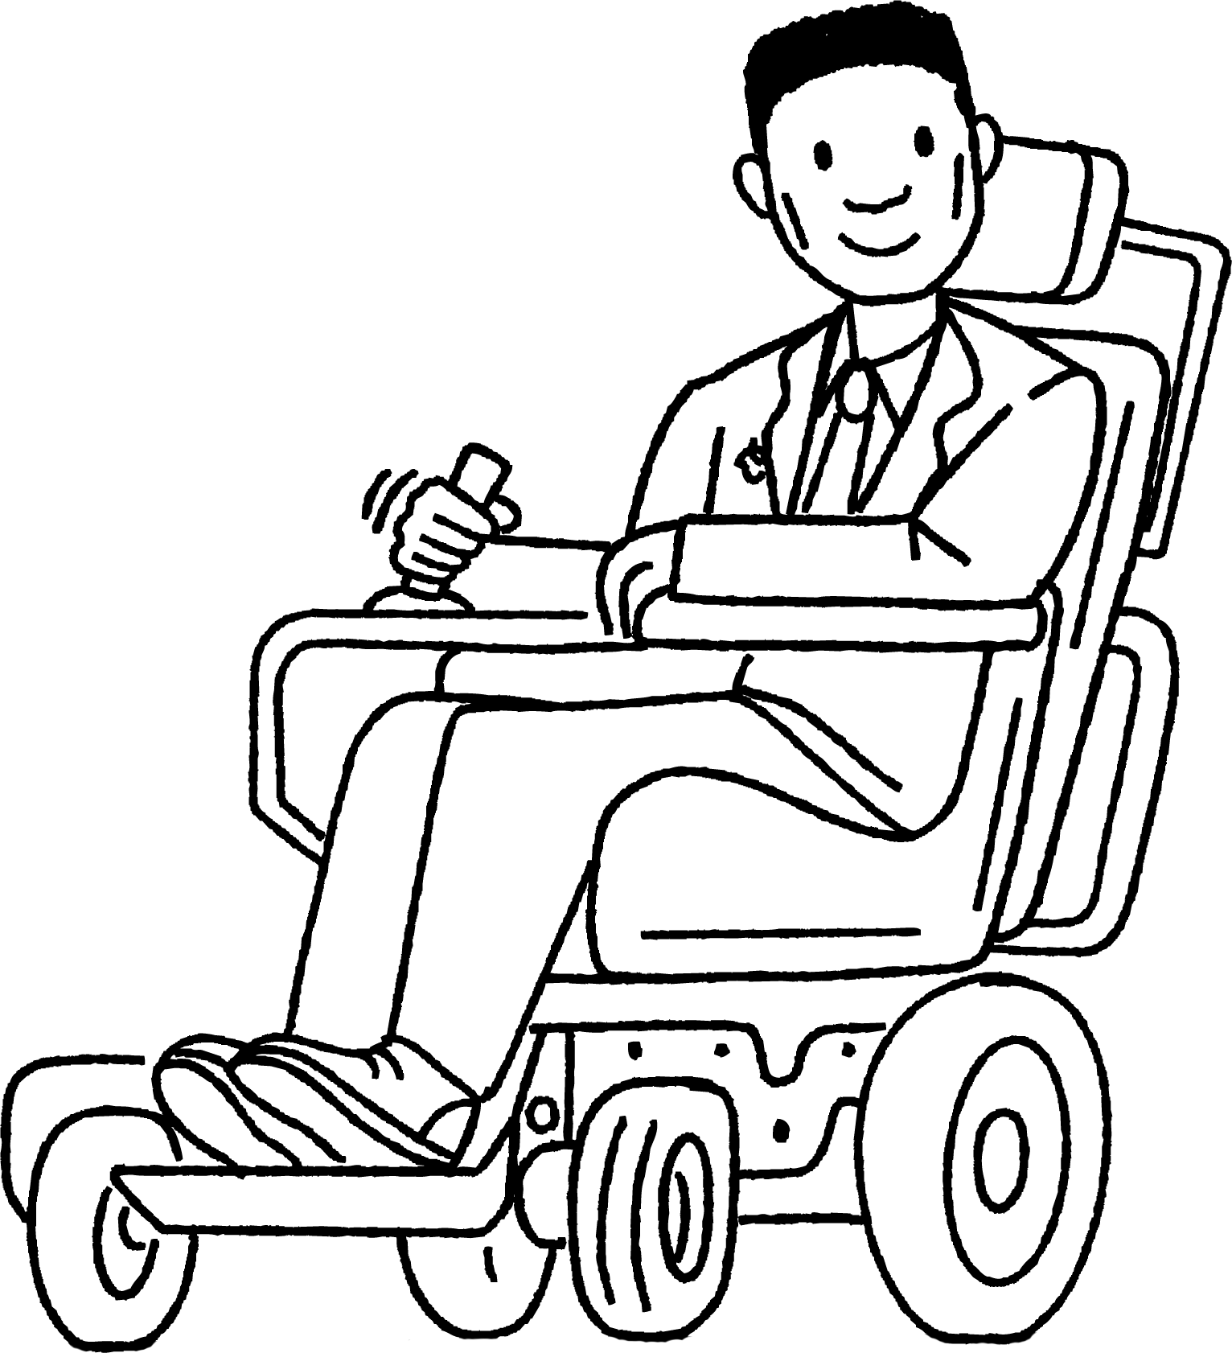
Composite solids
Composite prisms are prisms, so we must calculate the volume and surface area the same way.
Can we calculate the volume and surface area as separate prisms and then total them?
Jacob
Lucas

Slide 23
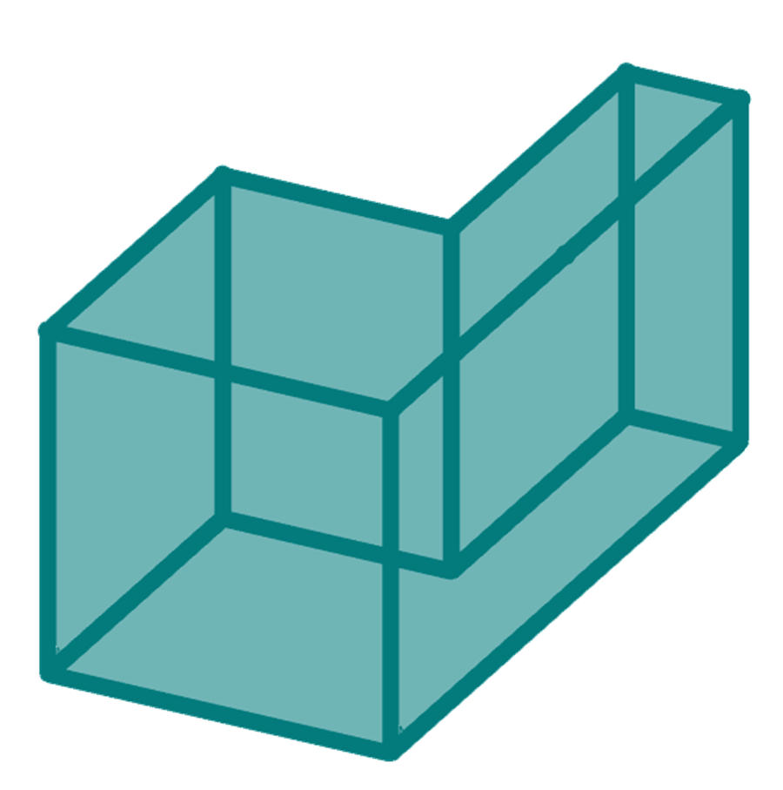
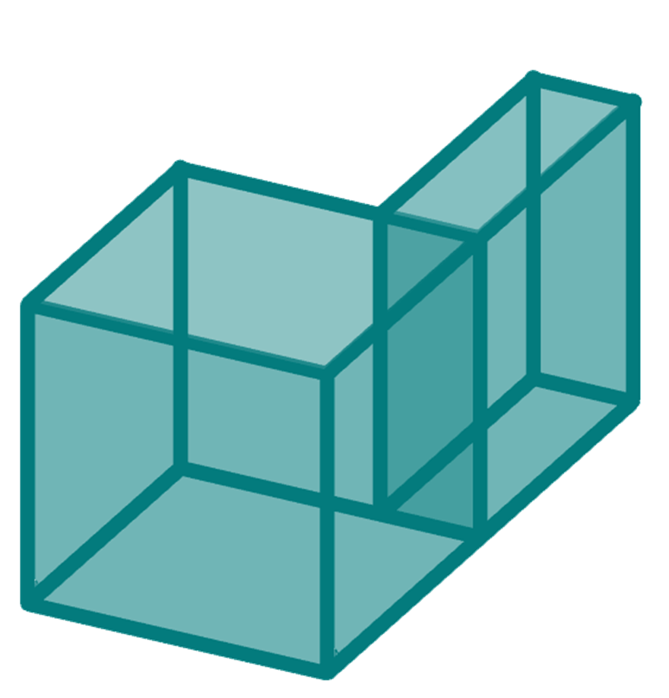

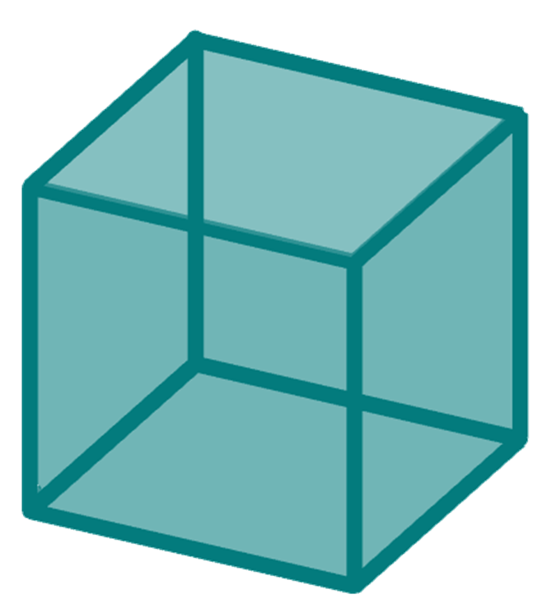
Composite solids
Here is a composite rectilinear prism. What happens to the volume when it is split into separate prisms?
The volume remains the same.

Slide 24
Composite solids
The volume of a composite solid remains the same when split into separate prisms.
This makes sense. A cake cut into slices doesn’t change the total amount of cake.
So is the surface area of the composite solid the same as the total of the surface area of its parts?

Slide 25
Composite solids
Here is a composite rectilinear prism. What happens to the surface area when it is split into separate prisms?
The surface area increases.

Slide 26
Composite solids
The surface area of the composite solid increases when split into separate prisms.
The additional surface area occurs where the two prisms join.
If you iced a whole cake versus icing the individual slices, you would use different amounts of icing.

Slide 27
Composite solids
The surface area of a composite solid is equal to the combined surface area of the solids that created it.
The solids created will join and ‘hide’ some of their surface area.
The volume of the composite solid is equal to the combined volume of the solids so it is the same for surface area.

Slide 28
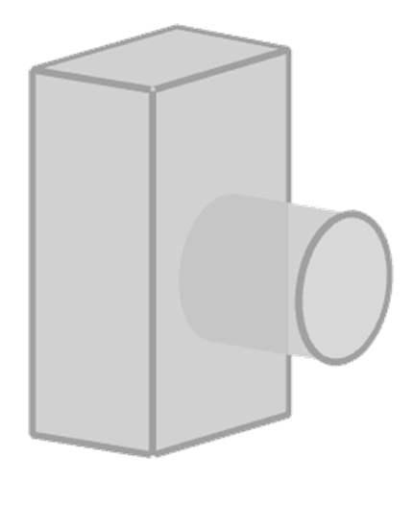
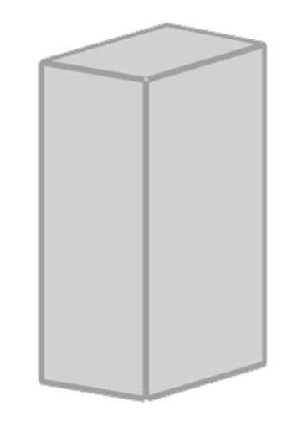
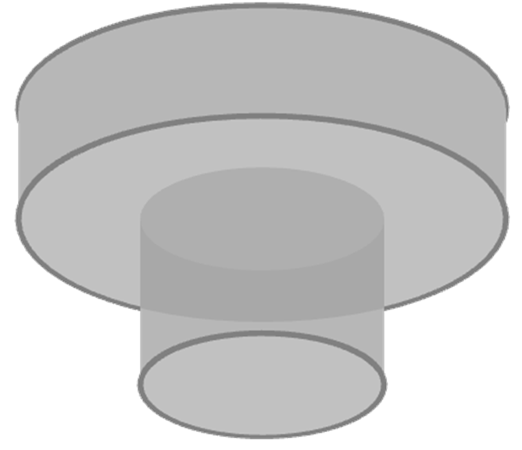

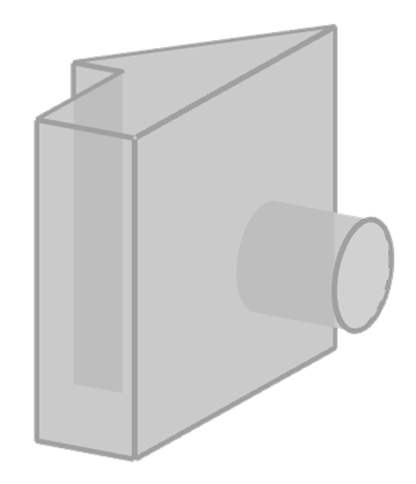
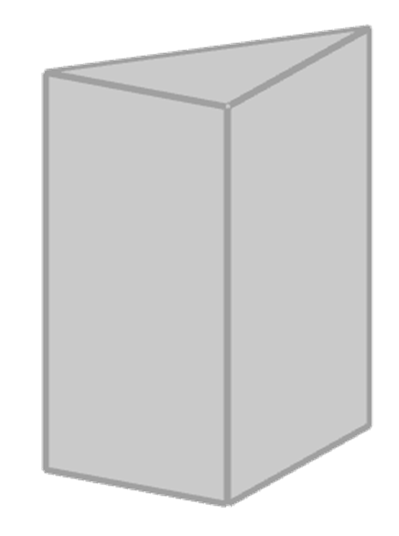
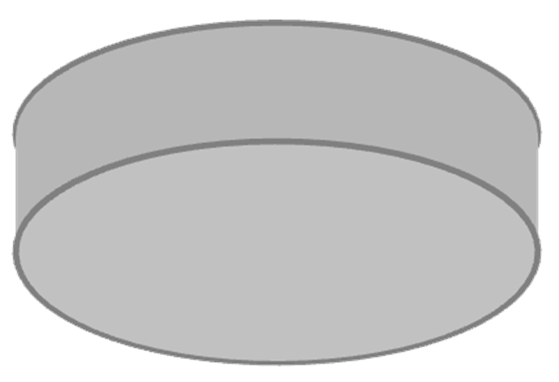
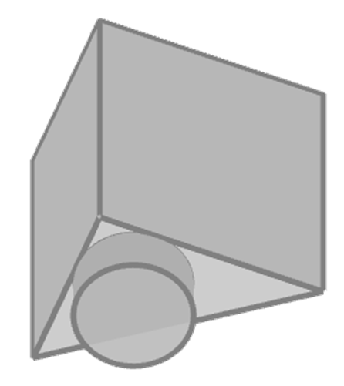
Composite solids
1) Match the composite solid with its parts.

Slide 29
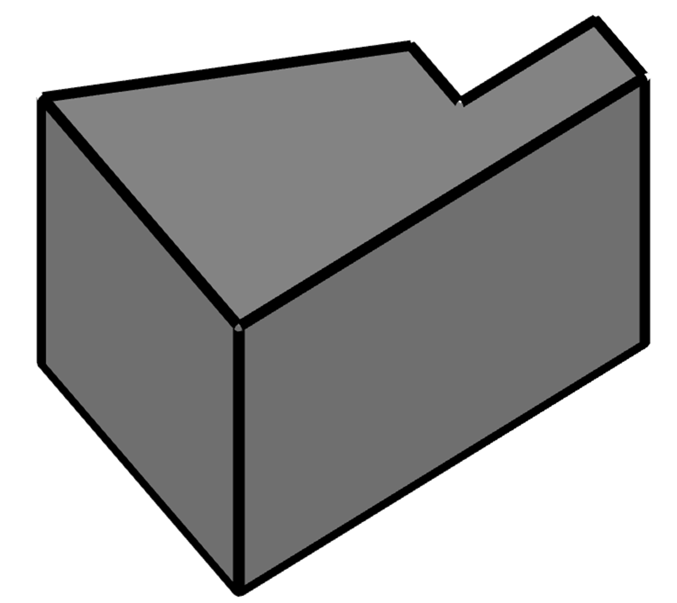
Composite solids
2) Calculate the volume of this prism.
16 mm
25 mm
8 mm
8 mm
22 mm
23 mm
40 mm

Slide 30
Composite solids
1) Match the composite solid with its parts.

Slide 31
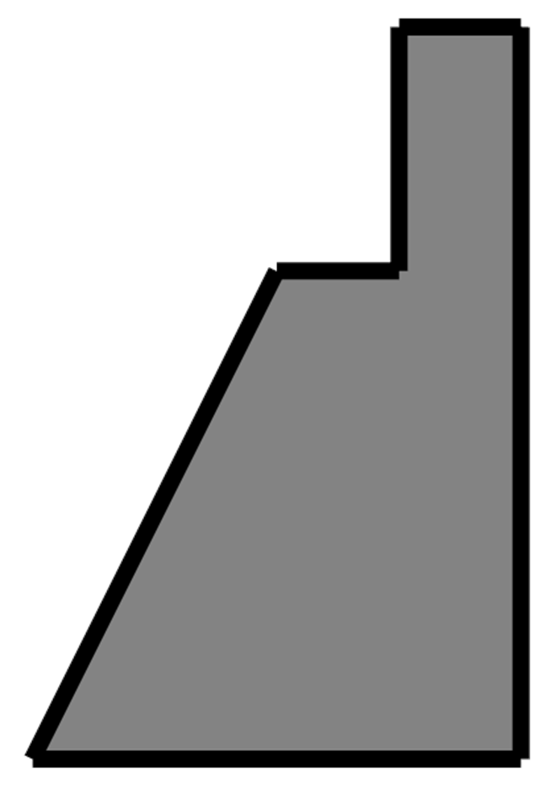
Composite solids
Area of A
= 8 × 16
= 128 mm²
2) Calculate the volume of this prism.
A
16 mm
25 mm
8 mm
8 mm
B
Area of B
= × (23 + 16) × 24
= 468 mm²
22 mm
Area of cross-section
= 128 + 468 = 596 mm²
23 mm
40 mm
Volume
= 596 × 22 = 13 112 mm³

Slide 32
Problem solving with perimeter, area and volume
Surface area and volume
Composite solids
Problems in context

Slide 33
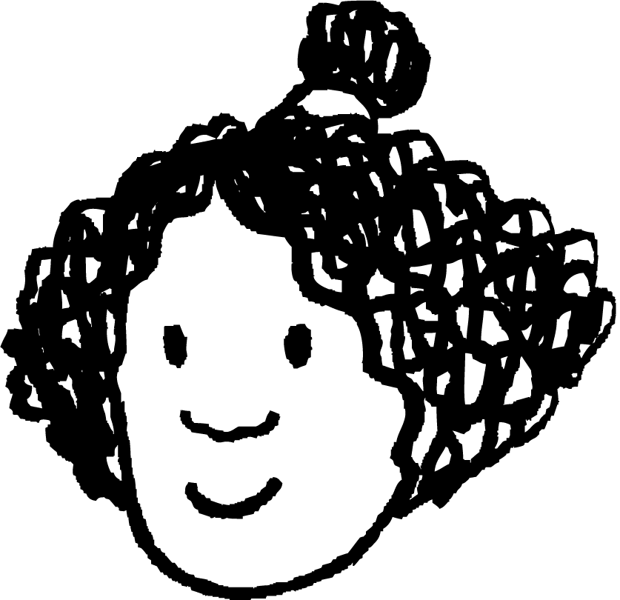


Problems in context
The outside of a garage is going to be painted.
Masonry paint comes in 10 litre pots and covers 14 m².
How many pots of paint are needed to paint a garage that is 4 m by 7 m by 2.5 m?
The area of the surfaces which will be painted is 55 m² so 4 tins would be needed.
The surface area would be 111 m² so 8 tins would be needed.
The volume is 70 m³, so 5 tins are needed.
Izzy
Aisha
Who is correct?
Laura

Slide 34
Problems in context
The outside of a garage is going to be painted.
Masonry paint comes in 10 litre pots and covers 14 m².
How many pots of paint are needed to paint a garage that is 4 m by 7 m by 2.5 m?
The volume is 70 m³, so 5 tins are needed.
Aisha cannot be correct.
The volume is the space inside the garage and that is not being painted. The units of volume are not consistent with the units for area.
Aisha

Slide 35
Problems in context
The outside of a garage is going to be painted.
Masonry paint comes in 10 litre pots and covers 14 m².
How many pots of paint are needed to paint a garage that is 4 m by 7 m by 2.5 m?
The surface area would be 111 m² so 8 tins would be needed.
Izzy has correctly calculated the surface area of a cuboid with the dimensions of the garage.
In context though, you would not be painting all the faces. Only the external walls.
Izzy

Slide 36
Problems in context
The outside of a garage is going to be painted.
Masonry paint comes in 10 litre pots and covers 14 m².
How many pots of paint are needed to paint a garage that is 4 m by 7 m by 2.5 m?
The area of the surfaces which will be painted is 55 m² so 4 tins would be needed.
Laura is correct.
There are four external walls. Two have an area of 10 m² and two have an area of 17.5 m².
You cannot buy parts of tins, so she has rounded up to a full tin.
Laura

Slide 37

Problems in context
Sort the following situations out into length, area or volume.
length | area | volume
Replacing the fence around a garden
a
Covering a wall in tiles
b
c
Christmas lights around a roofline
Amount of water collected in a water butt
d
e
Carpeting a floor
f
Framing a picture
g
Amount of air in a balloon

Slide 38
Problems in context
Sort the following situations out into length, area or volume.
length | area | volume
Replacing the fence around a garden
a
a
b
Covering a wall in tiles
d
b
c
e
g
c
Christmas lights around a roofline
Amount of water collected in a water butt
f
d
e
Carpeting a floor
f
Framing a picture
g
Amount of air in a balloon

Slide 39
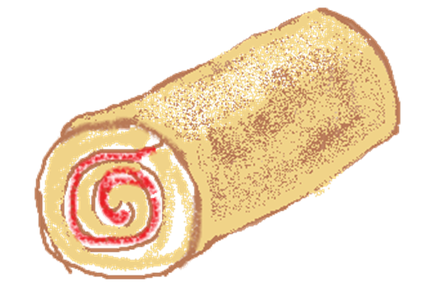
Problems in context
1) A baker makes 24 mini swiss rolls and wants to cover them in chocolate. How many square centimetres of chocolate will the baker have used?
8 cm
3 cm
2) A metal pole is melted down and remoulded into cubes with edges of 5 cm. How many cubes can be made from this pole?
7 cm
45 cm

Slide 40
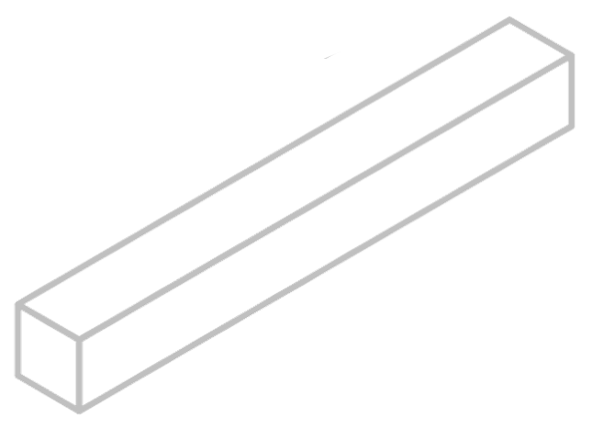
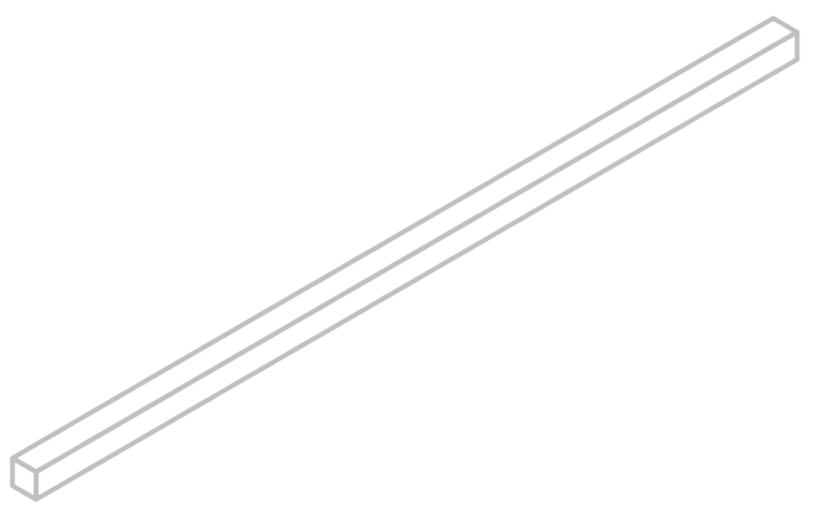
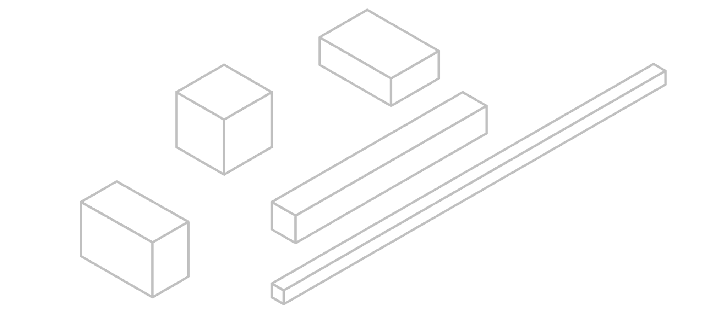
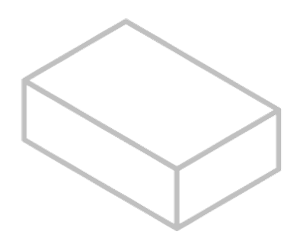
Problems in context
3) One factor that affects the rate of dissolving is the contact between the solute and the solvent.
Here are some sugar lumps (solute) of the same mass. When put in water (solvent), which would have:
a) the most contact?
b) the least contact?
 | l | w | h
A | 40 | 5 | 5
B | 20 | 10 | 5
C | 10 | 10 | 10
D | 250 | 2 | 2
E | 12.5 | 8 | 10
C
A
E
l = length (mm)
w = width (mm)
h = height (mm)
B
D

Slide 41
Problems in context
1) A baker makes 24 mini swiss rolls and wants to cover them in chocolate. How many square centimetres of chocolate will the baker have used?
Surface area = 2 × 𝜋 × 1.5² + 𝜋 × 3 × 8 = 28.5𝜋 cm²
8 cm
Chocolate used = 24 × 28.5𝜋 = 684𝜋 cm²
3 cm
2) A metal pole is melted down and remoulded into cubes with edges of 5 cm. How many cubes can be made from this pole?
Volume of pole = 𝜋 × 7² × 45 = 2205𝜋 cm³
7 cm
45 cm
Volume of cube = 5 × 5 × 5 = 125 cm³
Amount of cubes = 2205𝜋 ÷ 125 = 55.417…
55 cubes can be made

Slide 42
Problems in context
3) One factor that affects the rate of dissolving is the contact between the solute and the solvent.
Here are some sugar lumps (solute) of the same mass. When put in water (solvent), which would have:
a) the most contact?
b) the least contact?
 | l | w | h
A | 40 | 5 | 5
B | 20 | 10 | 5
C | 10 | 10 | 10
D | 250 | 2 | 2
E | 12.5 | 8 | 10
D - 2008 mm²
C - 600 mm²
C
A
E
l = length (mm)
w = width (mm)
h = height (mm)
B
D

Slide 43
Problem solving with perimeter, area and volume
There is often a link between volume and surface area as both are calculated using lengths.
The volume of a composite 3D object can be calculated by totalling the volume of the solids that created it.
The surface area of a composite 3D object is not the total of the surface areas for the solids that created it.
Identifying whether the question needs length, area or volume is the first stage to a problem in context question.

Slide 44

© Oak National Academy 2023.
Produced in partnership with Mathematics in Education and Industry.
Licensed on the Open Government Licence v3.0, except where otherwise stated. See Oak terms and conditions.

